Slide 1
Recruitment influencers
Irene Chen

Slide 2
Problem: Recruitment
Recruitment is a long and expensive process.
Even though most of the time our offers are accepted, several high-profile offers have been declined
Right now we don’t know what best explain if someone will accept an offer. Start by looking at financial influences.
Goal is to understand if and what financial factors that determine a successful offer (accepted) or failed offer (not accepted)

Slide 3
Hypothesis
Recruitment Costs Of Failed Searches is higher than that of Successful Searches
Biggest contribution to recruitment success is Housing support(because anecdotally we’ve heard how candidates from outside of Bay Area get sticker shock)

Slide 4
Descriptions of the dataset
From Employee Lifecycle system
Since I’m starting the analysis by looking at financial influences, I used data from “Recruitment Cost Report”
Key Columns in dataset (after massaging):
Recruitment ID (uniquely IDs each search)
Accepted (1 = Yes, 0 = No)
Starting Salary
Total Recruitment Cost
Bonus
Computer
Research Funding
Furniture
Moving
Other Grants
Research Assistant
Lab Setup / Equipment
Other
Childcare
Housing Exception (Internally Funded)
Rental Assistance
Spousal support

Slide 5
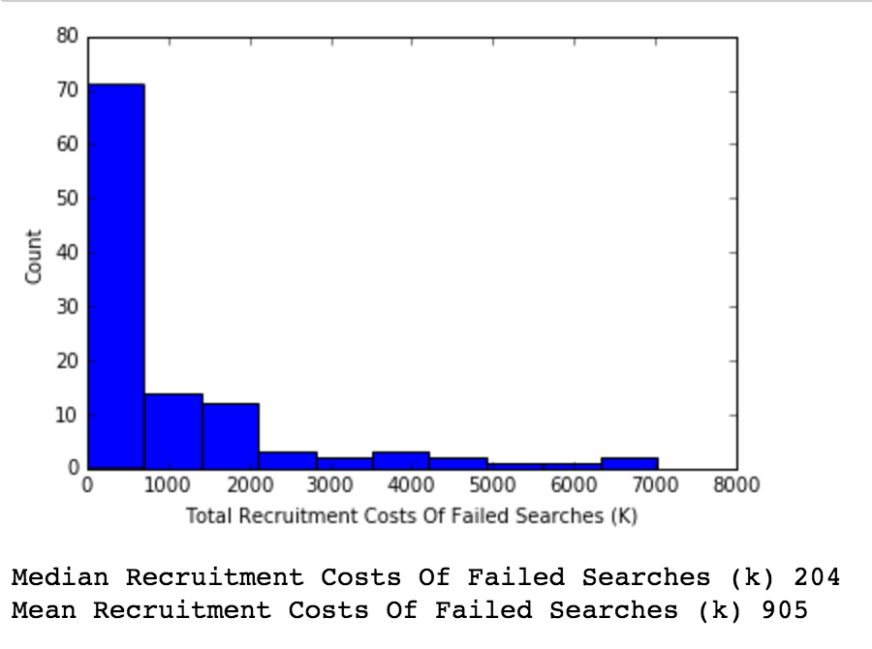
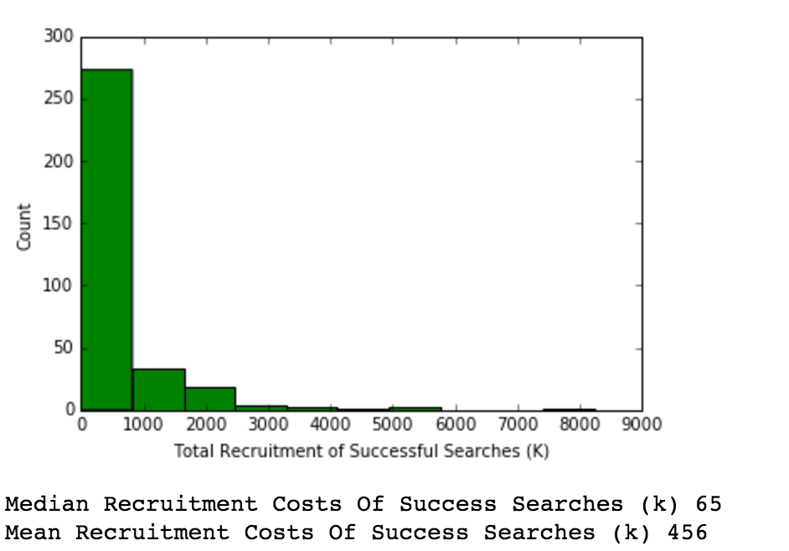
Descriptive Statistics
Total Recruits: 446
Total Failed Searches: 111
Total Successful Searches: 335
Success Rate: 75.11%
Median Cost of Failed Searches is more than 3x the Median cost of successful searches!

Slide 6
Model Selection
Output is qualitative, so will use classification algorithm.
I am looking to interpret
My output is dichotomous (accept/reject)
Will start with Logistic Regressions
First find relationship between different input and output variables
Then identify what has positive or negative effect on acceptance

Slide 7
Correlations between input variables
1 = Accepted offer0 = Rejected Offer
High Negative Correlations amongst
Research costs (-0.176467)
Total costs (-0.176193)*
Moving costs (-0.175417)
Spousal support (-0.136235
Starting Salary (-0.130356)
Lab Setup / Equipment costs (0.112081)
Low Positive Correlations amongst
Furniture(0.067218
Research Assistant (0.044975)
Computer Costs (0.029604)

Slide 8
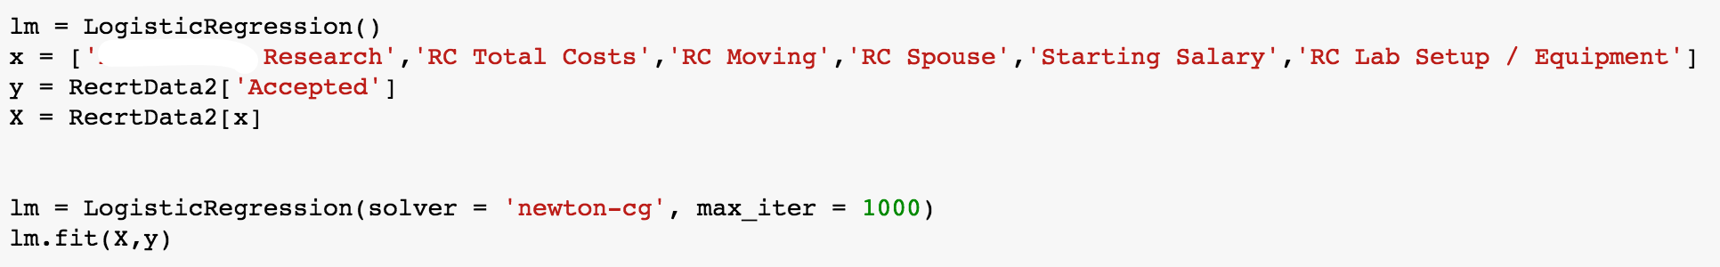
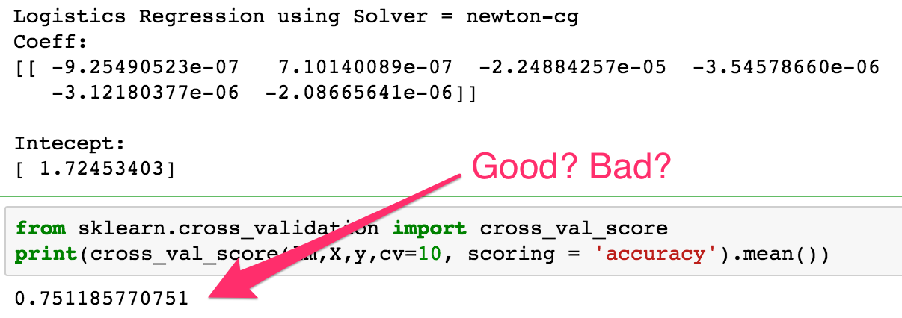
Interpretation using Logistical Model: Newton-cg

Slide 9
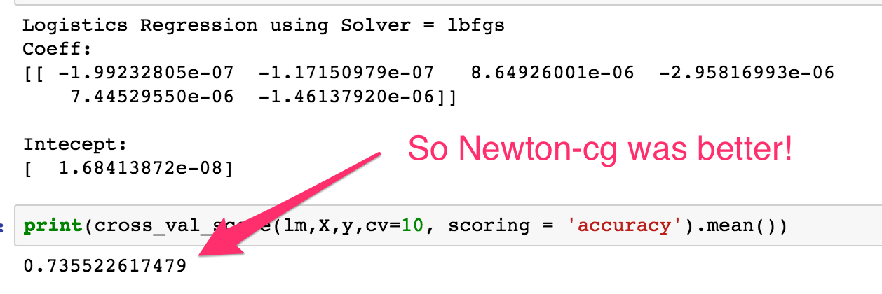
Interpretation using Logistical Model: lbfgs

Slide 10
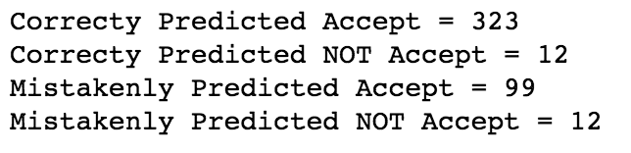
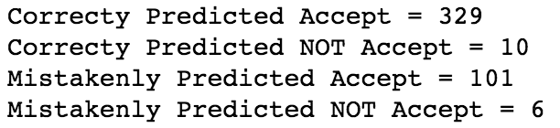
But comparing Confusion Matrix Results tell different story…..
Lbfgs
Newton-cg
Since it’s more costly to mistakenly predict when someone will accept (and in reality they Decline), I would prefer the lbfgs method over the Newton-cg method (the difference between the 2 is small I’ll admit…)

Slide 11
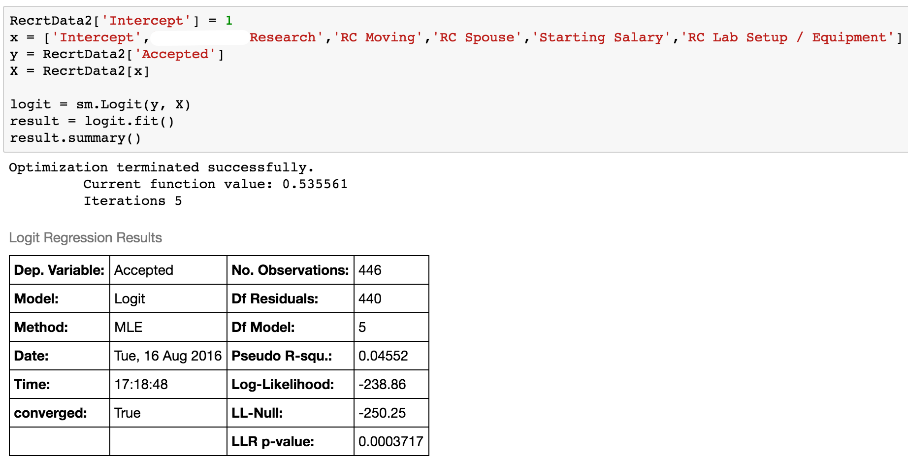
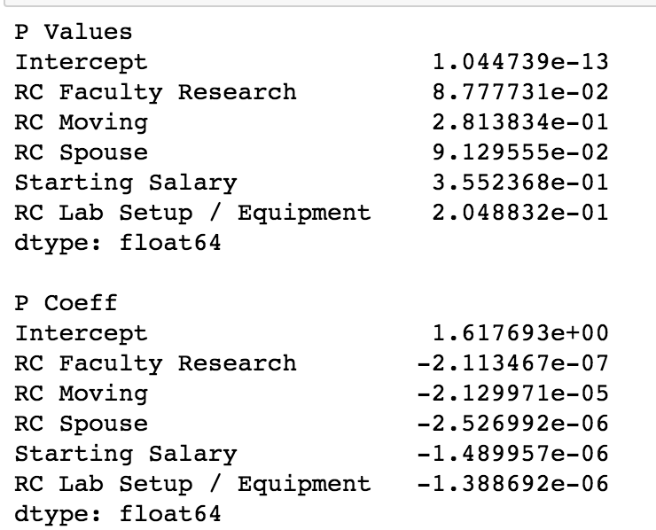
Interpretation using Logistical Model: logit from statsmodels.api
But as shown by the small coefficients, we know the affects of recruitment costs is minimal.

Slide 12
Summary: What did I learn, next steps
There are 14 factors that make up recruitment costs but only 5 make any difference.
But as shown by the small coefficients, we know the affects of those 5 factors are minimal.
More data on other (non-financial) reasons why offers get rejected are needed. From a different dataset, I can get of offers rejections broken down by the following reasons:
Benefits
Children
Facilities
Family
Geography
Housing
Organizational Loyalty
Organizational Reputation
Politics
Research Support
Salary
Spouse does not want to relocate
Spousal Employment
Other
Non-Financial input variables is where I’d like to explore next

